Slide 1
Chapter 4: Loops

Slide 2
TA Office Hours
The location is MC 4A
Meng Tuesday 2:30 – 3:30
Neda Wednesday 2:30 – 3:30 and Thursday 2:30 – 3:30

Slide 3
Chapter Goals
To implement while and for loops
To hand-trace the execution of a program
To become familiar with common loop algorithms
To understand nested loops
To implement programs that read and process data sets
To use a computer for simulations
In this chapter, you will learn about loop statements in Python, as well as techniques for writing programs that simulate activities in the real world.

Slide 4
Contents
The while loop
Problem Solving: Hand-Tracing (HW)
Application: Processing Sentinels
Problem Solving: Storyboards (HW)
Common Loop Algorithms
The for loop
Nested loops
Processing Strings
Application: Random Numbers and Simulation
Graphics: Digital Image Processing
Problem Solving: Solve a Simpler Problem First

Slide 5
The while Loop

Slide 6
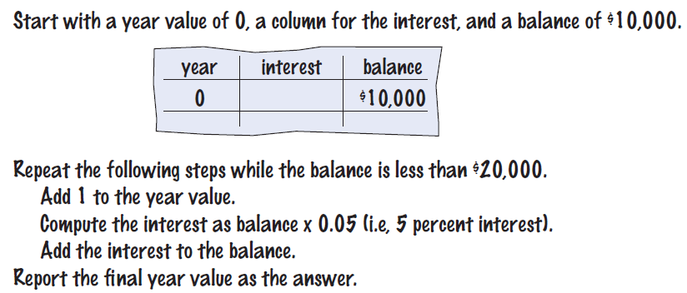
The while Loop
Examples of loop applications
Calculating compound interest
Simulations, event driven programs
Drawing tiles…
Compound interest algorithm (Chapter 1)
Steps

Slide 7
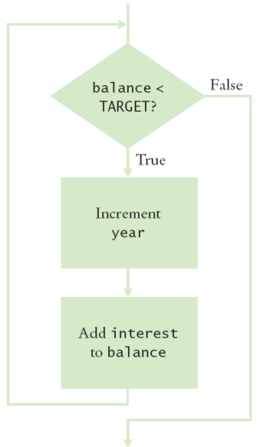
Planning the while Loop
balance = 10.0
target = 100.0
year = 0
rate = 0.025
while balance < TARGET :
year = year + 1
interest = balance * RATE/100
balance = balance + interest
A loop executes instructions repeatedly while a condition is True.

Slide 8
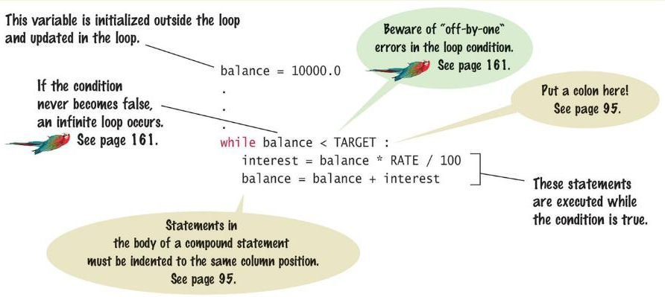
Syntax: while Statement

Slide 9
Count-Controlled Loops
A while loop that is controlled by a counter
counter = 1 # Initialize the counter
while counter <= 10 : # Check the counter
print(counter)
counter = counter + 1 # Update the loop variable

Slide 10
Event-Controlled Loops
A while loop that is controlled by a counter
balance = INITIAL_BALANCE # Initialize the loop variable
while balance <= TARGET: # Check the loop variable
year – year + 1
balance = balance * 2 # Update the loop variable

Slide 11
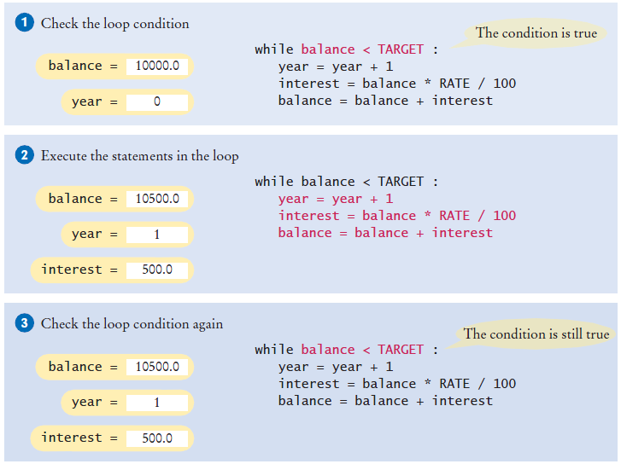
Execution of the Loop

Slide 12
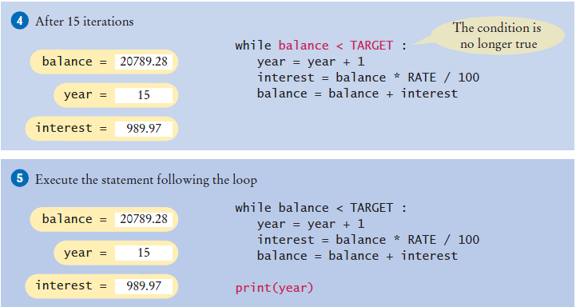
Execution of the Loop (2)

Slide 13
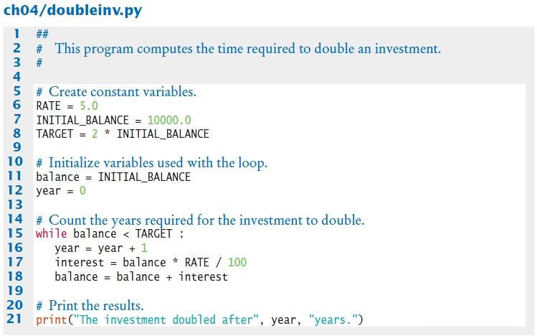
Doubleinv.py
Declare and initialize a variable outside of the loop to count year
Increment the year variable each time through

Slide 14
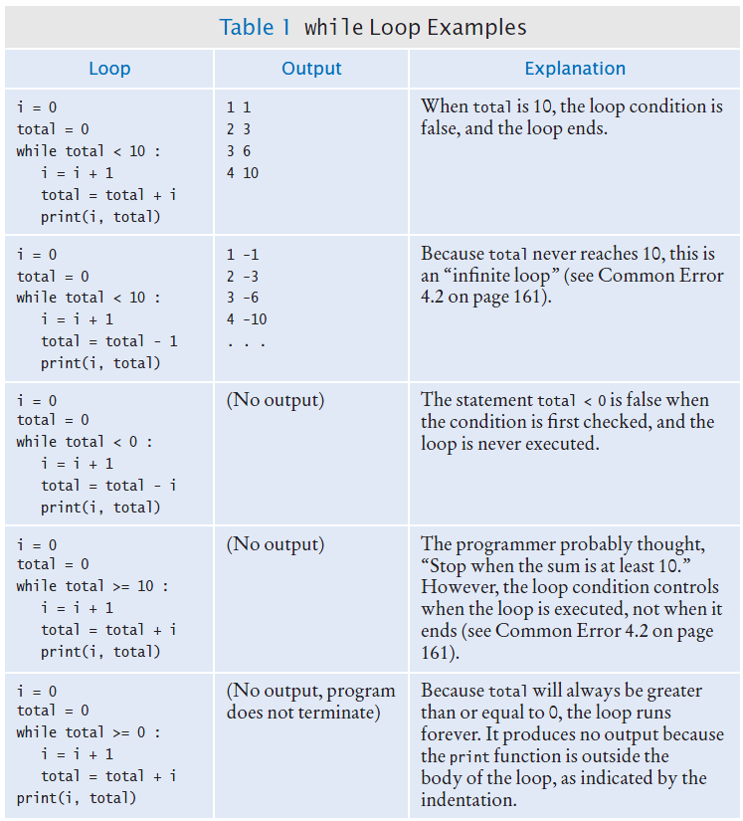
while Loop Examples

Slide 15
while Loop Examples (2)

Slide 16
Common Error: Incorrect Test Condition
The loop body will only execute if the test condition is True.
If bal is initialized as less than the TARGET and should grow until it reaches TARGET
Which version will execute the loop body?
while bal >= TARGET :
year = year + 1
interest = bal * RATE
bal = bal + interest
while bal < TARGET :
year = year + 1
interest = bal * RATE
bal = bal + interest

Slide 17
Common Error: Infinite Loops
The loop body will execute until the test condition becomes False.
What if you forget to update the test variable?
bal is the test variable (TARGET doesn’t change)
You will loop forever! (or until you stop the program)
while bal < TARGET :
year = year + 1
interest = bal * RATE
bal = bal + interest

Slide 18
Common Error: Off-by-One Errors
A ‘counter’ variable is often used in the test condition
Your counter can start at 0 or 1, but programmers often start a counter at 0
If I want to paint all 5 fingers on one hand, when I am done?
If you start at 0, use “<“ If you start at 1, use “<=“
0, 1, 2, 3, 4 1, 2, 3, 4, 5
finger = 0
FINGERS = 5
while finger < FINGERS :
# paint finger
finger = finger + 1
finger = 1
FINGERS = 5
while finger <= FINGERS :
# paint finger
finger = finger + 1

Slide 19
Summary of the while Loop
while loops are very common
Initialize variables before you test
The condition is tested BEFORE the loop body
This is called pre-test
The condition often uses a counter variable
Something inside the loop should change one of the variables used in the test
Watch out for infinite loops!

Slide 20
Short Demo with Zybooks
Section 5.2

Slide 21
Peer Programming
Write a program that prints to the screen all multiples of 4 between 5 and 50 (inclusive)

Slide 22
Sentinel Values

Slide 23
Processing Sentinel Values
Sentinel values are often used:
When you don’t know how many items are in a list, use a ‘special’ character or value to signal the “last” item
For numeric input of positive numbers, it is common to use the value -1
A sentinel value denotes the end of a data set, but it is not part of the data.
salary = 0.0
while salary >= 0 :
salary = float(input())
if salary >= 0.0 :
total = total + salary
count = count + 1

Slide 24
Averaging a Set of Values
Declare and initialize a ‘total’ variable to 0
Declare and initialize a ‘count’ variable to 0
Declare and initialize a ‘salary’ variable to 0
Prompt user with instructions
Loop until sentinel value is entered
Save entered value to input variable (‘salary’)
If salary is not -1 or less (sentinel value)
Add salary variable to total variable
Add 1 to count variable
Make sure you have at least one entry before you divide!
Divide total by count and output.
Done!

Slide 25
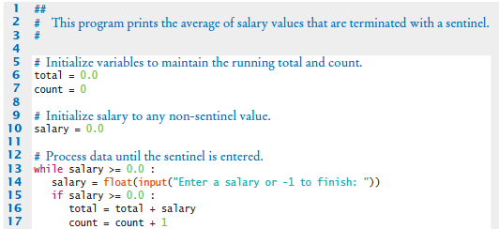
Sentinel.py (1)
Outside the while loop: declare and initialize variables to use
Since salary is initialized to 0, the while loop statements will execute at least once
Input new salary and compare to sentinel
Update running total and count (to calculate the average later)

Slide 26

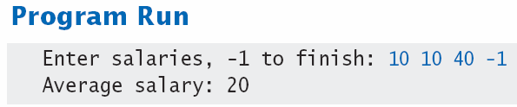
Sentinel.py (2)
Prevent divide by 0
Calculate and output the average salary using the total and count variables

Slide 27
Priming Read
Some programmers don’t like the “trick” of initializing the input variable with a value other than a sentinel.
# Set salary to a value to ensure that the loop
# executes at least once.
salary = 0.0
while salary >= 0 :
An alternative is to change the variable with a read before the loop.
salary = float(input("Enter a salary or -1 to finish: "))
while salary >= 0 :

Slide 28
Modification Read
The input operation at the bottom of the loop is used to obtain the next input.
# Priming read
salary = float(input("Enter a salary or -1 to finish: "))
while salary >= 0.0 :
total = total + salary
count = count + 1
# Modification read
salary = float(input("Enter a salary or -1 to finish:
"))

Slide 29
Boolean Variables and Sentinels
A boolean variable can be used to control a loop
Sometimes called a ‘flag’ variable
done = False
while not done :
value = float(input("Enter a salary or -1 to finish: "))
if value < 0.0:
done = True
else :
# Process value
Initialize done so that the loop will execute
Set done ‘flag’ to True if sentinel value is found

Slide 30
THURSDAY

Slide 31
Common Loop Algorithms

Slide 32
Common Loop Algorithms
Sum and Average Value
Counting Matches
Prompting until a Match Is Found
Maximum and Minimum
Comparing Adjacent Values

Slide 33
Average Example
Average of Values
First total the values
Initialize count to 0
Increment per input
Check for count 0
Before divide!
total = 0.0
count = 0
inputStr = input("Enter value: ")
while inputStr != "" :
value = float(inputStr)
total = total + value
count = count + 1
inputStr = input("Enter value: ")
if count > 0 :
average = total / count
else :
average = 0.0

Slide 34
Sum Example
Sum of Values
Initialize total to 0
Use while loop with sentinel
total = 0.0
inputStr = input("Enter value: ")
while inputStr != "" :
value = float(inputStr)
total = total + value
inputStr = input("Enter value: ")

Slide 35
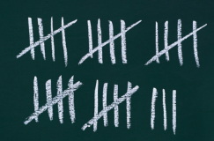
Counting Matches (e.g., Negative Numbers)
Counting Matches
Initialize negatives to 0
Use a while loop
Add to negatives per match
negatives = 0
inputStr = input("Enter value: ")
while inputStr != "“ :
value = int(inputStr)
if value < 0 :
negatives = negatives + 1
inputStr = input("Enter value: ")
print("There were", negatives, "negative values.")

Slide 36
Prompt Until a Match is Found
Initialize boolean flag to False
Test sentinel in while loop
Get input, and compare to range
If input is in range, change flag to True
Loop will stop executing
valid = False
while not valid :
value = int(input("Please enter a positive value < 100: "))
if value > 0 and value < 100 :
valid = True
else :
print("Invalid input.")
This is an excellent way to validate use provided inputs

Slide 37
Maximum
Get first input value
By definition, this is the largest that you have seen so far
Loop while you have a valid number (non-sentinel)
Get another input value
Compare new input to largest (or smallest)
Update largest if necessary
largest = int(input("Enter a value: "))
inputStr = input("Enter a value: ")
while inputStr != "“ :
value = int(inputStr)
if value > largest :
largest = value
inputStr = input("Enter a value: ")

Slide 38
Minimum
Get first input value
This is the smallest that you have seen so far!
Loop while you have a valid number (non-sentinel)
Get another input value
Compare new input to largest (or smallest)
Update smallest if necessary
smallest = int(input("Enter a value: "))
inputStr = input("Enter a value: ")
while inputStr != “” :
value = int(inputStr)
if value < smallest :
smallest = value
inputStr = input("Enter a value: ")

Slide 39
Comparing Adjacent Values
Get first input value
Use while to determine if there are more to check
Copy input to previous variable
Get next value into input variable
Compare input to previous, and output if same
value = int(input("Enter a value: "))
inputStr = input("Enter a value: ")
while inputStr != "“ :
previous = value
value = int(inputStr)
if value == previous :
print("Duplicate input")
inputStr = input("Enter a value: ")

Slide 40
The for Loop

Slide 41
The for Loop
Uses of a for loop:
The for loop can be used to iterate over the contents of any container.
A container is is an object (Like a string) that contains or stores a collection of elements
A string is a container that stores the collection of characters in the string

Slide 42
An Example of a for Loop
Note an important difference between the while loop and the for loop.
In the while loop, the index variable i is assigned 0, 1, and so on.
In the for loop, the element variable is assigned stateName[0], stateName[1], and so on.
stateName = "Virginia"
i = 0
while i < len(stateName) :
letter = stateName[i]
print(letter)
i = i + 1
while version
stateName = "Virginia"
for letter in stateName :
print(letter)
for version

Slide 43
The for Loop (2)
Uses of a for loop:
A for loop can also be used as a count-controlled loop that iterates over a range of integer values.
i = 1
while i < 10 :
print(i)
i = i + 1
while version
for i in range(1, 10) :
print(i)
for version

Slide 44
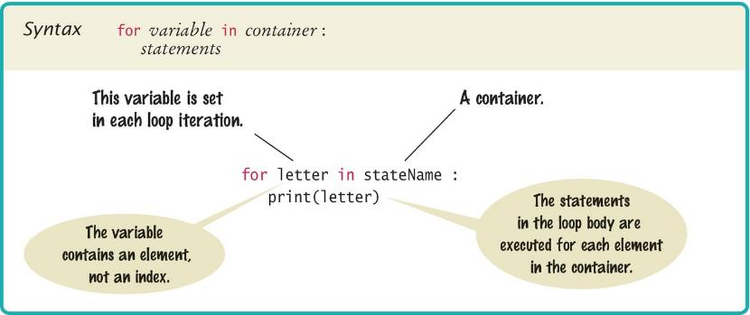
Syntax of a for Statement (Container)
Using a for loop to iterate over the contents of a container, an element at a time.

Slide 45
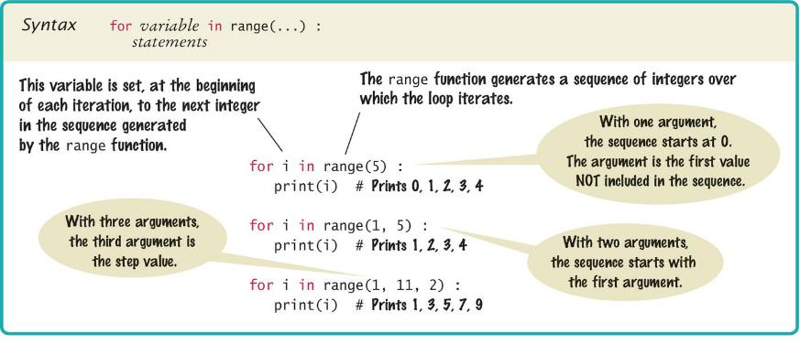
Syntax of a for Statement (Range)
You can use a for loop as a count-controlled loop to iterate over a range of integer values
We use the range function for generating a sequence of integers that less than the argument that can be used with the for loop

Slide 46
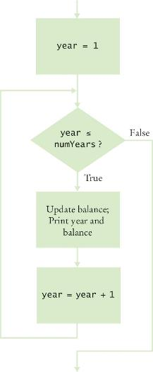
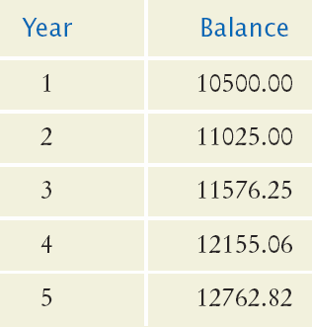

Planning a for Loop
Print the balance at the end of each year for a number of years

Slide 47
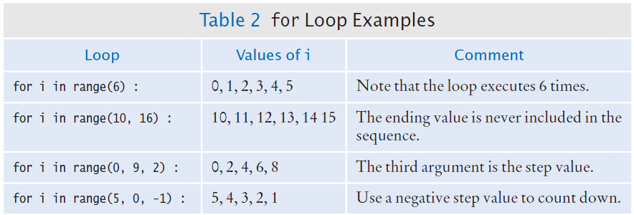
Good Examples of for Loops
Keep the loops simple!

Slide 48
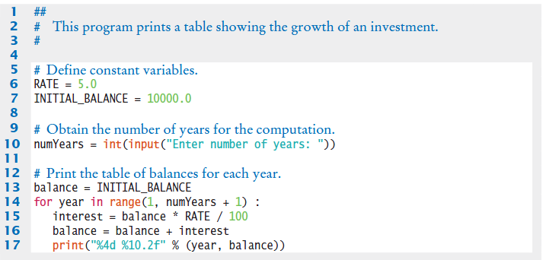
Investment Example

Slide 49
Programming Tip
Finding the correct lower and upper bounds for a loop can be confusing.
Should you start at 0 or at 1?
Should you use <= b or < b as a termination condition?
Counting is easier for loops with asymmetric bounds.
The following loops are executed b - a times.
int i = a
while i < b :
. . .
i = i + 1
for i in range(a, b) :
. . .

Slide 50
Programming Tip
The loop with symmetric bounds (“<=”, is executed b - a + 1 times.
That “+1” is the source of many programming errors.
i = a
while i <= b :
. . .
i = i + 1
# For this version of the loop the ‘+1’ is very noticeable!
for year in range(1, numYears + 1) :

Slide 51
Summary of the for Loop
for loops are very powerful
The for loop can be used to iterate over the contents of any container, which is an object that contains or stores a collection of elements
a string is a container that stores the collection of characters in the string.
A for loop can also be used as a count-controlled loop that iterates over a range of integer values.

Slide 52
Programming Activity
Create a program that asks the user for a positive number and sums up all even numbers between 0 and that number.
For instance if a user enters 5, your program should print The sum of even numbers between 0 and 5 is 6

Slide 53
Programming Activity
Create a program that finds the average of a number of student grades. First ask the instructor how many grades they plan to add and then get all the grades from the instructor and output the average.

Slide 54
While vs. For
As a general rule:
Use a for loop when the number of iterations is computable before entering the loop, as when counting down from X to 0, printing a string N times, etc.
Use a for loop when accessing the elements of a container, as when adding 1 to every element in a list, or printing the key of every entry in a dict, etc.
Use a while loop when the number of iterations is not computable before entering the loop, as when iterating until a user enters a particular character.

Slide 55
Steps to Writing a Loop
Planning:
Decide what work to do inside the loop
Specify the loop condition
Determine loop type
Setup variables before the first loop
Process results when the loop is finished
Trace the loop with typical examples
Coding:
Implement the loop in Python

Slide 56
A Special Form of the print Function
Python provides a special form of the print function that does not start a new line after the arguments are displayed
This is used when we want to print items on the same line using multiple print statements
For example the two statements:
print(“00”, end=””)
print(3 + 4)
Produce the output:
007
Including end=“” as the last argument to the print function prints an empty string after the arguments, instead on a new line
The output of the next print function starts on the same line

Slide 57
Nested Loops

Slide 58
Loops Inside of Loops
In Chapter Three we learned how to nest if statements to allow us to make complex decisions
Remember that to nest the if statements we need to indent the code block
Complex problems sometimes require a nested loop, one loop nested inside another loop
The nested loop will be indented inside the code block of the first loop
A good example of using nested loops is when you are processing cells in a table
The outer loop iterates over all of the rows in the table
The inner loop processes the columns in the current row

Slide 59
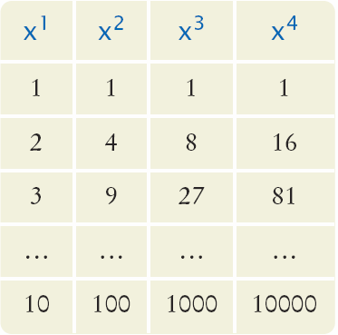
HW: Our Example Problem Statement
Print a Table Header that contains x¹, x², x³, and x⁴
Print a Table with four columns and ten rows that contain the powers of x¹, x², x³, and x⁴ for x = 1 to 10

Slide 60
Hand Tracing the Loop
i will have the values:
0, 1, 2, 3 – So we will have four lines of stars
j will have the values
0 - So we will have one star
0, 1 - So we will have two stars
0, 1, 2 - So we will have three stars
0, 1, 2, 3 - So we will have four stars

Slide 61
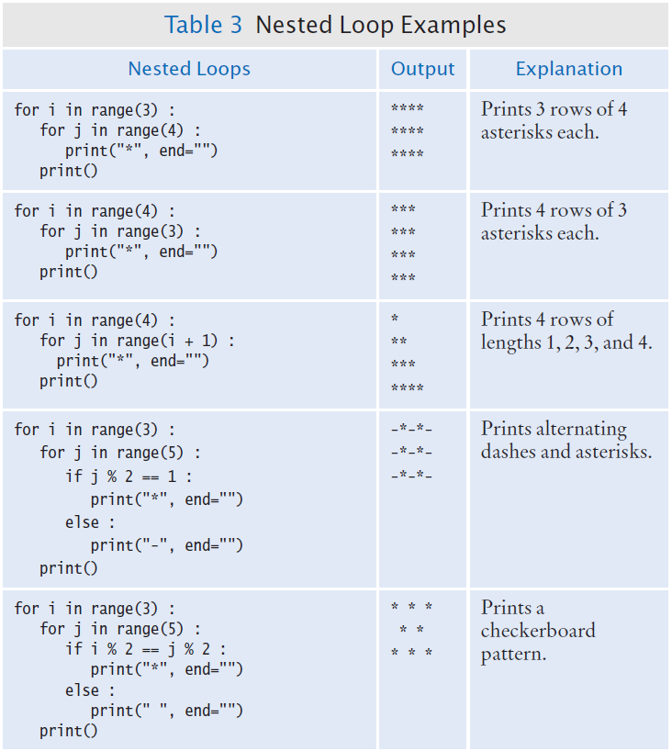
Nested Loop Examples

Slide 62
Nested Loop Examples (2)

Slide 63
Exam Prep.
What does the following code output
for i in range(3) : for j in range(1, 3) : print(i + j, end="") print()

Slide 64
Second Problem Statement
Print the following pattern of brackets:
[][][][]
[][][][]
[][][][]
The pattern consists of:
Three rows
Each row has four pairs of brackets
What do we know?
We need two nested loops
The first loop (the outer loop) will print each of the three rows
The second loop (the inner loop) will print the four pairs of brackets

Slide 65
Pseudocode Code, Results
For i = 1 to 3
For j = 1 to 4
Print “[]”
Print a new line

Slide 66
Formatting Input and Output
#1. Adding variables to input for x in range(1,4): value = int(input('Please enter number %d: ' %(x))) print(value) #2. Left and Right adjusting text # If the text if numeric first convert to string x = 1000 for x in range(0,10000,1000): print(repr(x).rjust(3)) #3. If it is a string then you don't need to do that str1 = 'This is a table' print(str1.rjust(len(str1)+5))
For more on formatting https://docs.python.org/3/tutorial/inputoutput.html

Slide 67


Slide 68
0
0
5
4
3
2
1
0
0
9
8
7
6
5
4
3
2
1
0
9
8
7
6
5
4
3
2
1
0
9
8
7
6
5
4
3
2
1
0
9
8
7
6
5
4
3
2
1
0
9
8
7
6
5
4
3
2
1
0
9
8
7
6
5
4
3
2
1
0
0
5
0
4
Hours
Minutes
Seconds

Slide 69
0
0
5
4
3
2
1
0
0
9
8
7
6
5
4
3
2
1
0
9
8
7
6
5
4
3
2
1
0
9
8
7
6
5
4
3
2
1
0
9
8
7
6
5
4
3
2
1
0
9
8
7
6
5
4
3
2
1
0
9
8
7
6
5
4
3
2
1
0
0
4
0
3
Hours
Minutes
Seconds

Slide 70
0
0
5
4
3
2
1
0
0
9
8
7
6
5
4
3
2
1
0
9
8
7
6
5
4
3
2
1
0
9
8
7
6
5
4
3
2
1
0
9
8
7
6
5
4
3
2
1
0
9
8
7
6
5
4
3
2
1
0
9
8
7
6
5
4
3
2
1
0
0
3
0
2
Hours
Minutes
Seconds

Slide 71
0
0
5
4
3
2
1
0
0
9
8
7
6
5
4
3
2
1
0
9
8
7
6
5
4
3
2
1
0
9
8
7
6
5
4
3
2
1
0
9
8
7
6
5
4
3
2
1
0
9
8
7
6
5
4
3
2
1
0
9
8
7
6
5
4
3
2
1
0
0
2
0
1
Hours
Minutes
Seconds

Slide 72
0
0
5
4
3
2
1
0
0
9
8
7
6
5
4
3
2
1
0
9
8
7
6
5
4
3
2
1
0
9
8
7
6
5
4
3
2
1
0
9
8
7
6
5
4
3
2
1
0
9
8
7
6
5
4
3
2
1
0
9
8
7
6
5
4
3
2
1
0
0
1
0
0
Hours
Minutes
Seconds

Slide 73
Exam Averages Problem Statement
It is common to repeatedly read and process multiple groups of values:
Write a program that can compute the average exam grade for multiple students.
Each student has the same number of exam grades
Prompt the user for the number of exams
When you finish a student prompt the user to see if there are more students to process
What do we know?
What do we need to compute?
What is our algorithm / approach?

Slide 74
Step One: Understand the Problem
To compute the average grade for a student, we must read and tally all of the grades for that student
We can use a loop to do this. (we have working code to do this portion)
We need to compute grades for multiple students
That implies a set of nested Loops
The outer loop processes each student
The inner loop process the student’s grades

Slide 75
Step Two
Compute the grade for one student
Set up the variables and loop
We know how many grades to process, so we can use a count-controlled loop
total score = 0
For i in range (1, number of exams + 1) :
Read the next exam score
Add the exam score to the total score
Compute the exam average
Print the exam average

Slide 76
Step Three
Repeat the process for each student
Since we don’t know how many students there are, we will use a while loop with a sentinel value
For simplicity we will use “Y” as the sentinel value

Slide 77
Step Four: Translate to Python

Slide 78
Exam Averages Example
Open the file:
examaverages.py
Notice that the second loop (the for loop) is nested inside the while loop

Slide 79
Processing Strings

Slide 80
Processing Strings
A common use of loops is to process or evaluate strings.
For example, you may need to count the number of occurrences of one or more characters in a string or verify that the contents of a string meet certain criteria.

Slide 81
String Processing Examples
Counting Matches
Finding All Matches
Finding the First or Last Match
Validating a String
Building a New String

Slide 82
Counting Matches
Suppose you need to count the number of uppercase letters contained in a string.
We can use a for loop to check each character in the string to see if it is upper case
The loop below sets the variable char equal to each successive character in the string
Each pass through the loop tests the next character in the string to see if it is uppercase
uppercase = 0
for char in string :
if char.isupper() :
uppercase = uppercase + 1

Slide 83
Counting Vowels
Suppose you need to count the vowels within a string
We can use a for loop to check each character in the string to see if it is in the string of vowels “aeiuo”
The loop below sets the variable char equal to each successive character in the string
Each pass through the loop tests the lower case of the next character in the string to see if it is in the string “aeiou”
vowels = 0
for char in word :
if char.lower() in "aeiou" :
vowels = vowels + 1

Slide 84
Finding All Matches Example
When you need to examine every character in a string, independent of its position we can use a for statement to examine each character
If we need to print the position of each uppercase letter in a sentence we can test each character in the string and print the position of all uppercase characters
We set the range to be the length of the string
We test each character
If it is uppercase we print I, its position in the string
sentence = input("Enter a sentence: ")
for i in range(len(sentence)) :
if sentence[i].isupper() :
print(i)

Slide 85
Finding the First Match
This example finds the position of the first digit in a string.
found = False
position = 0
while not found and position < len(string) :
if string[position].isdigit() :
found = True
else :
position = position + 1
if found :
print("First digit occurs at position", position)
else :
print("The string does not contain a digit.")

Slide 86
Finding the Last Match
Here is a loop that finds the position of the last digit in the string.
This approach uses a while loop to start at the last character in a string and test each value moving from the end of the string to the start of the string
Position is set to the length of the string - 1
If the character is not a digit, we decrease position by 1
Until we find a digit, or process all the characters
found = False
position = len(string) - 1
while not found and position >= 0 :
if string[position].isdigit() :
found = True
else :
position = position - 1

Slide 87
Validating a String
In the United States, telephone numbers consist of three parts––area code exchange, and line number––which are commonly specified in the form (###)###-####.

Slide 88
Validating a String (code)
We can examine a string to ensure that it contains a correctly formatted phone number. (e.g., (703)321-6753)
The loop test each character to see it it is correct for its position, or a number
valid = len(string) == 13
position = 0
while valid and position < len(string) :
valid = ((position == 0 and string[position] != "(")
or (position == 4 and string[position] != ")")
or (position == 8 and string[position] != "-")
or (position != 0 and position != 4 and position != 8
and string[position].isdigit())) :
position = position + 1

Slide 89
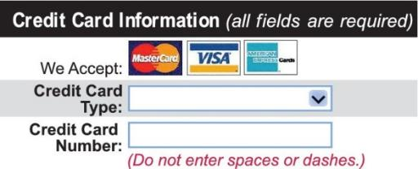
Building a New String
One of the minor annoyances of online shopping is that many web sites require you to enter a credit card without spaces or dashes, which makes double-checking the number rather tedious.
How hard can it be to remove dashes or spaces from a string?

Slide 90
Building a New String (code)
The contents of a string cannot be changed.
But nothing prevents us from building a new string.
Here is a loop that builds a new string containing a credit card number with spaces and dashes removed:
We read the credit card number
We initialize a new string to the empty string
We test each character in the user input
If the character is not a space or dash we append it to the new string
userInput = input("Enter a credit card number: ")
creditCardNumber = ""
for char in userInput :
if char != " " and char != "-" :
creditCardNumber = creditCardNumber + char

Slide 91
Application: Random Numbers and Simulations

Slide 92
Random Numbers/Simulations
Games often use random numbers to make things interesting
Rolling Dice
Spinning a wheel
Pick a card
A simulation usually involves looping through a sequence of events
Days
Events

Slide 93
Generating Random Numbers
The Python library has a random number generator that produces numbers that appear to be random
The numbers are not completely random. The numbers are drawn from a sequence of numbers that does not repeat for a long time
random() returns a number that is >= 0 and < 1

Slide 94
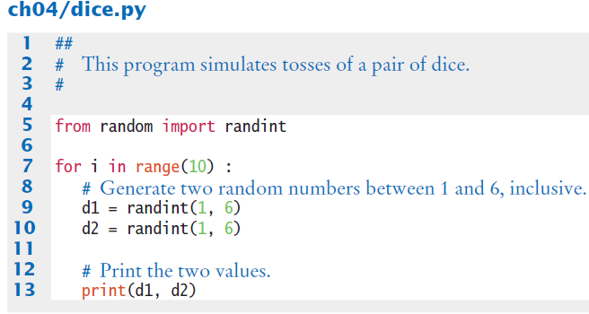
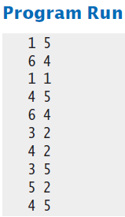
Simulating Die Tosses
Goal:
To generate a random integer in a given range we use the randint() function
Randint has two parameters, the range (inclusive) of numbers generated

Slide 95
Summary

Slide 96
Summary: Two Types of Loops
while Loops
for Loops
while loops are very commonly used (general purpose)
Uses of the for loop:
The for loop can be used to iterate over the contents of any container.
A for loop can also be used as a count-controlled loop that iterates over a range of integer values.

Slide 97
Summary
Each loop requires the following steps:
Initialization (setup variables to start looping)
Condition (test if we should execute loop body)
Update (change something each time through)
A loop executes instructions repeatedly while a condition is True.
An off-by-one error is a common error when programming loops.
Think through simple test cases to avoid this type of error.

Slide 98
Summary
A sentinel value denotes the end of a data set, but it is not part of the data.
You can use a boolean variable to control a loop.
Set the variable to True before entering the loop
Set it to False to leave the loop.
Loops can be used in conjunction with many string processing tasks

Slide 99
Summary
In a simulation, you use the computer to simulate an activity.
You can introduce randomness by calling the random number generator.

